Slide 1
Adult Income Analysis Presentation
This presentation provides an overview and insights into predicting whether an individual's income exceeds $50K per year.

Slide 2
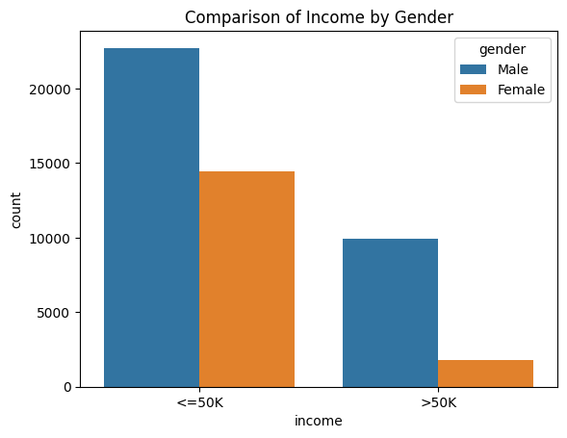
Income Distribution by Gender
This plot highlights a noticeable difference in income distribution between males and females. Males tend to have a higher proportion of individuals earning above $50K compared to females. This observation underscores the importance of addressing gender income disparities in various sectors, from workplaces to policy-making.

Slide 3
Business Problem
Understand Target Groups
Inform Policy Decisions
Income data enables governments to formulate policies that address economic inequality.
Knowing income levels allows organizations to identify and understand their target customer groups.
Products and services can be designed and marketed specifically for high, middle, or low income individuals.
Target Marketing Campaigns
Assess Creditworthiness
Guide Public Spending
Knowledge of income levels allows optimal allocation of public resources.
Advertisers can direct promotions at specific income brackets based on purchasing power.
Banks use income data to determine loan eligibility and tailor credit products.

Slide 4



Stakeholders
Financial institutions
Government agencies
Marketing firms
Can use analysis to gauge creditworthiness and design financial products for different income groups
Can utilize analysis for policymaking, taxation, welfare programs, and public services based on income
Can develop targeted campaigns appealing to specific income groups' needs and preferences
Key stakeholders can leverage the income analysis for tailored services, policies, and strategies.

Slide 5


Data Source & Description
Source
Key Attributes
UCI Machine Learning Repository
age, workclass, education, marital status, occupation, race, sex, capital gain, capital loss, hours per week, native country
Census data from 1994
over 50 variables describing demographic, employment, and financial attributes
*Adapted from the UCI Machine Learning Repository

Slide 6
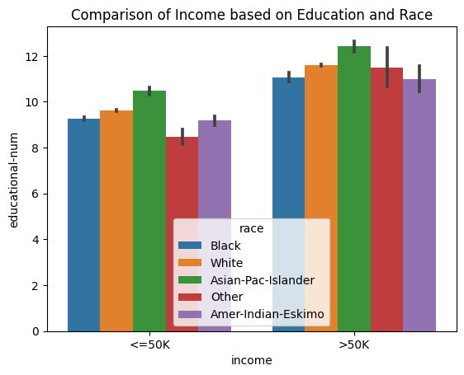
Income Distribution by Race
From this plot, it's evident that there are disparities in income distribution across different racial groups. Some racial groups have a higher proportion of individuals earning above $50K compared to others. It's crucial for stakeholders to recognize these disparities and ensure that policies and strategies are equitable across all racial groups.

Slide 7
Model Performance
Model
Used a random forest classifier to predict income levels based on census data.
Key Metrics
The model achieved an accuracy of 85% and RMSE of 0.32 on the test set.

Slide 8



Offer financial literacy programs
Recommendations & Conclusion
Expand public transportation access
Increase minimum wage

Slide 9
“"The unexamined life is not worth living." - Socrates”
SOCRATES

